Slide 1

Dr. Akhilesh Das Gupta Institute of Information Technology and Management
INDUSTRIAL TRAINING
MACHINE LEARNING
Authorized by STANFORD UNIVERSITY
Offered through COURSERA
Project: Malaria Cell Detection

Slide 2
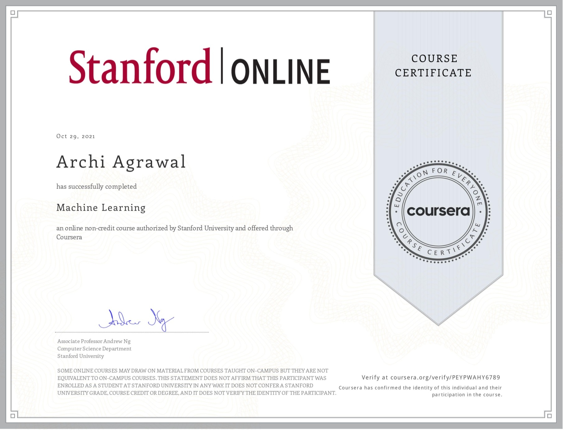
Certificate

Slide 3
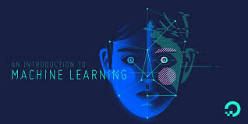
Learning
Introduction
Linear Regression with One Variable
Linear Algebra Review
Linear Regression with Multiple Variables
Logistic Regression
Regularization
Neural Networks: Representation
Neural Networks: Learning
Machine Learning System Design
Support Vector Machines
Unsupervised Learning
Dimensionality Reduction
Anomaly Detection
Recommender Systems
Large Scale Machine Learning

Slide 4
Malaria Cell Detection Introduction
Malaria has been one of the major causes of death in Africa, and being able to classify malaria-infected cell images is pivotal to the quick diagnosis of Malaria.
The project ‘Malaria Cell Detection’ is based on the concept of transfer learning and Convolution Neural Networks (CNN), which is a subset of Machine Learning.
It predicts whether the given image of the cell of a human being is parasitized or uninfected.

Slide 5
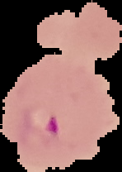

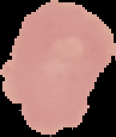
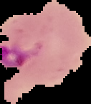


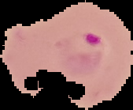
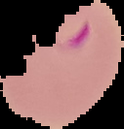
Images of Cells
Parasitized
Uninfected

Slide 6
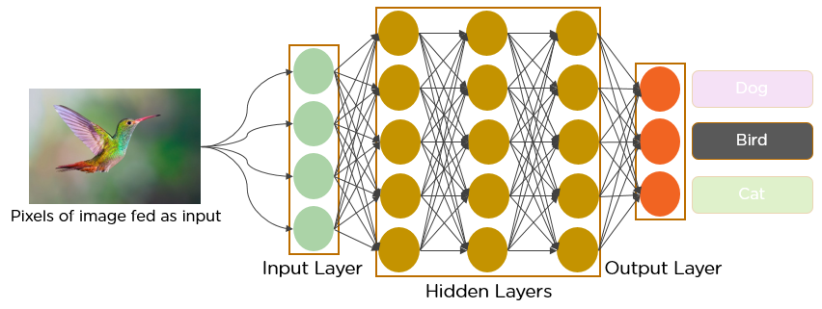
Convolutional Neural Network
A Convolutional Neural Network (CNN) is a class of deep neural networks, most commonly applied to analyze visual imagery.
Takes in an input image, assigns importance (learnable weights and biases) to various aspects/objects in the image and differentiate them.

Slide 7
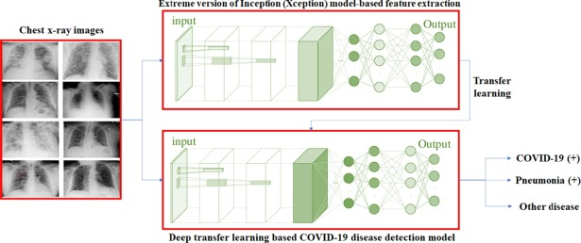
Transfer learning
Deep CNN models may take days or even weeks to train on very large datasets.
A way to short-cut this process is to re-use the model weights from pre-trained models that were developed for standard computer vision benchmark datasets, such as the ImageNet image recognition tasks.

Slide 8
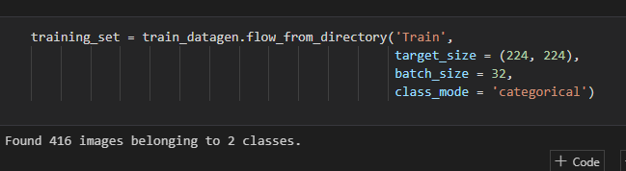

Working of the Project Model Development
Training
Testing

Slide 9
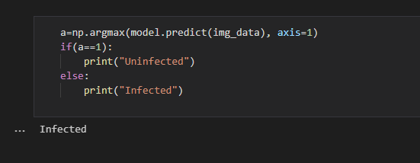
Working of the Project Model Prediction
The Output finally predicts whether the new input image is parasitized or uninfected, as a result of learning from model training.

Slide 10
Conclusion
Concepts of Machine Learning and Neural Networks can be extended to the development of similar models in the healthcare sector for classification and further identification of various diseases.
For example, Pneumonia detection, tomato leaf disease, Parkinson’s disease, et cetera.

Slide 11
Archi Agrawal 03815603119 B.Tech. (IT) Semester- V
Department of Information Technology
Industrial Training (11 Weeks)
Submitted by:

